Slide 1
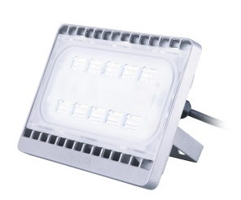
SmartBright Flood BVP161
Reliable Savings, lasting brightness
Ajay K R
Product Management – Outdoor
Professional Lighting

Slide 2

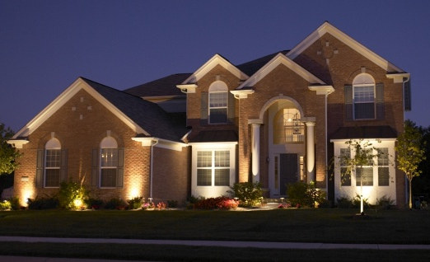
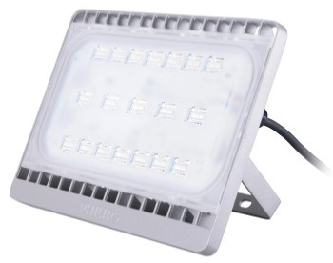

SmartBright LED Flood
30W
50W
70W
LED
Unique Selling Points:
  Reliable Savings : Up to 90% energy saving, compared with Philips Halolite QVF type Halogen lamps
  Lasting Brightness : Best LED’s with high system efficacy of 85lm/w
  Robust: 4KV Surge protection, IP65, IK07, 30k hours @Ta 35°C
  High Performance Compact design : Evenly distributed LED’s for effective heat transmission*
2
*As compared to COB based market flood lights

Slide 3
Features and benefits
Use with peace of mind
  • 4KV Surge Protection
  • IK07 classification
  • IP65 certified
  • Overheating protection function
Long-lasting performance
  • Designed for energy savings of up to 90% compared with conventional lighting
  • L70 30k hours*
  • Designed for operations under diverse environment from -40˚C to 45˚C
  *Designed to sustain 70% of initial lumen output (L70) at 30,000 hours of lifetime
High-quality materials and design
  • Toughened and shatter-proof quality lens enhances safety
  • Pressure die-cast housing offers excellent corrosion-resistance and robustness
Wide selection
  • Multiple choice of color temperature –
  Warm white (3000k), Neutral (4000k) and Cool white (5700k)
  • Multiple choice of lumen packages
5

Slide 4
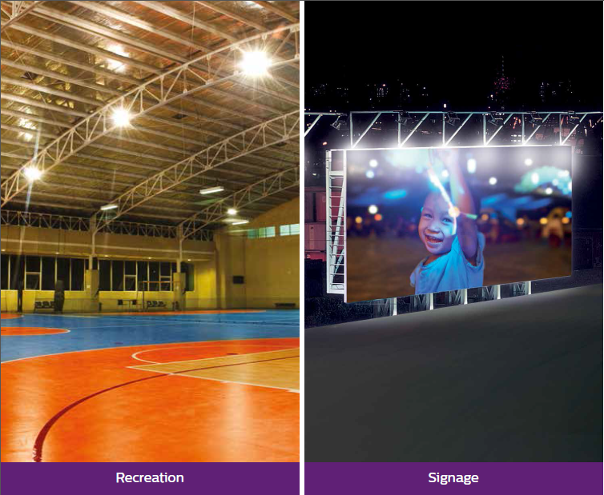
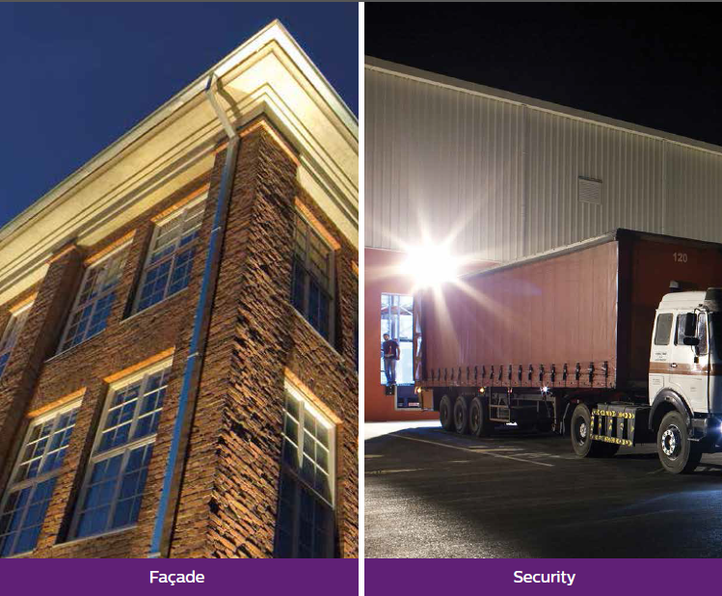
Application
Other applications : garden, footpath, car park…
6

Slide 5
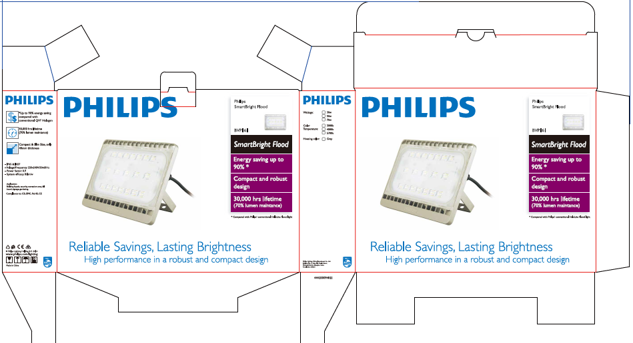
Package in full colour with USP’s
11

Slide 6
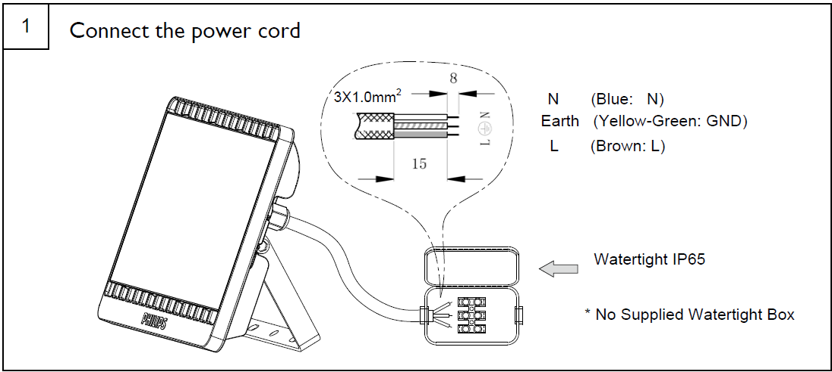

Mounting Instruction :
Water tight IP65 box not supplied

Slide 7
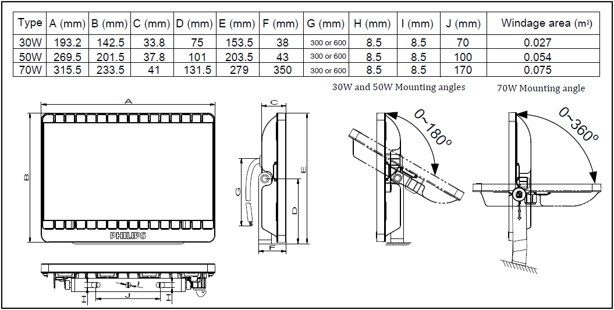
Dimensions

Slide 8
Ordering information
Ordering code, 12NC | Product Description | MoQ | Packing box dimension (mm) | Gross Wt (Kg) | Net wt (Kg) | Outbox dimension (mm) | Outerbox GrossWt (Kg)
911401619503 | BVP161 LED55/WW 70W 220-240V WB GREY IN | 6 | 370 x 285 x 75 | 2.35 | 2.00 | 450 x 390 x 310 | 14.10
911401619603 | BVP161 LED26/NW 30W 220-240V WB GREY IN | 16 | 205 x 155 x 68 | 0.70 | 0.60 | 410 x 280 x 310 | 11.60
911401619703 | BVP161 LED43/NW 50W 220-240V WB GREY IN | 8 | 280x 215 x 70 | 1.35 | 1.20 | 540 x 280 x 320 | 11.30
911401619803 | BVP161 LED60/NW 70W 220-240V WB GREY IN | 6 | 370 x 285 x 75 | 2.35 | 2.00 | 450 x 390 x 310 | 14.10
911401619903 | BVP161 LED26/CW 30W 220-240V WB GREY IN | 16 | 205 x 155 x 68 | 0.70 | 0.60 | 410 x 280 x 310 | 11.60
911401620003 | BVP161 LED60/CW 70W 220-240V WB GREY IN | 6 | 205 x 155 x 68 | 0.70 | 0.60 | 410 x 280 x 310 | 11.60
911401620103 | BVP161 LED43/CW 50W 220-240V WB GREY IN | 8 | 280x 215 x 70 | 1.35 | 1.20 | 540 x 280 x 320 | 11.30
911401620203 | BVP161 LED23/WW 30W 220-240V WB GREY IN | 16 | 205 x 155 x 68 | 0.70 | 0.60 | 410 x 280 x 310 | 11.60
911401620303 | BVP161 LED39/WW 50W 220-240V WB GREY IN | 8 | 280x 215 x 70 | 1.35 | 1.20 | 540 x 280 x 320 | 11.30
8

Slide 9
Detailed Specification
Model name | BVP161
Product hierarchy | A49 644505 | A49 644505 | A42 644505
Power | 30W | 50W | 70W
Lumen output | 2300lm(WW), 2600lm (NW, CW) | 3900lm(WW), 4300lm (NW, CW) | 5500lm(WW), 6000lm (NW, CW)
CCT | 3000K/4000K/5700K
CRI | 70
System Efficacy | 85lm/w
Insulation classification | Class I
Connection | 300mm flying wire
Volt/Frequency | 220-240V/50-60Hz
Power factor | 0.9
IP rating | IP65
IK rating | IK07
Surge protection | 4KV
Lifetime | 30,000 hrs @Ta 35°C
Ambient Temp | -40~45°C
Dimension | 193.2 x 142.2 x 40.9mm | 269.4 x 201.2 x 40.4mm | 315.4 x 232.9 x 40.9mm
Casing colour | Grey
Certificate | CE
Note : All are nominal values at Nominal operating voltage 220 -240V and will vary +/-10%
7

